Slide 1

temporal preferences
University of Padova
Italy
K. Brent Venable

Slide 2
I apologize…
for missing references in my contribution in the proceedings…
you can find a version with references on my web page:
www.math.unipd.it/~kvenable

Slide 3








What’s the idea?
I have to be back in my office by Friday morning!
Some flights on Thursday with the same (minimum) cost:
Stuttgard
9:45 15:30
Hamburg
8:30
Venice
16:30
Dusseldorf
7:30 12:30
Hamburg
6:30
Venice
13:40
Dusseldorf
11:35 12:30
Hamburg
10:05
Venice
13:40
6:30
7:30
8:30
9:30
10:30
11:30
12:30
13:30
14:30
15:30
16:30

Slide 4

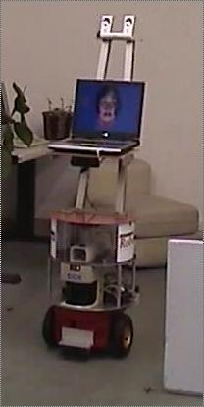
Examples of applications
Temporal Preferences for the MERs
Preferences on when to perform a given activity
Preferences on the interleaving times
between activities
[Rossi,Sperduti,Venable,Khatib,Morris,Morris 2002]
Assistive systems
Modeling
  Preferences of elders
  Preferences of caregivers
Monitoring
  Flexibility on detecting plan-execution discrepancies
Intervention
  Preference on reminders and actions
An example is the RoboCare project [Cesta et. al, 2007]

Slide 5


In the large universe of temporal reasoning
there is the galaxy of constraint-based temporal reasoning
and the galaxy of temporal preferences
we will explore only the space in their intersection
Constraint-based temporal reasoning
Temporal
preferences

Slide 6
Outline
Preferences as soft constraints
Preferences in constraint-based temporal frameworks
Preferences and uncertainty
Future directions

Slide 7
Preferences as soft constraints

Slide 8
Constraints
Many real-life problems can be modeled via constraints
Ex.:
  “I need at least two bedrooms”
  “I don’t want to spend more than 100K”
Constraint = requirement = relation among objects (values for variables) of the problem
Solution of a constraint problem = object choice (variable assignment) such that all constraints are satisfied
Constraint programming offers
  Natural modeling frameworks
  Efficient solvers
  Many application domains
    Scheduling, timetabling, resource allocation, vehicle routing, ...

Slide 9
Why is this not enough?
Constraints address compactness and efficiency but not expressivity
Over-constrained problems
  it does not make sense to just say that there is no solution
Optimization problems
  Also multi-criteria
Problems with both preferences and hard statements
  ex.: time-tabling (hard constraints about space and time, soft constraints about teachers)
Problems with uncertainty

Slide 10
The c-semiring framework
Variables {X₁,…,X_{n}}=X
Domains {D(X₁),…,D(X_{n})}=D
C-semiring <A,+,x,0,1>:
  A set of preferences
  + additive operator, inducing the ordering: a≥b iff a+b=a (idempotent, commutative, associative, unit element 0);
  x multiplicative operator: combines preferences (commutative, associative, unit element 1, absorbing element 0)
  0,1 respect. bottom and top element
  x distributes over +
[Bistarelli, Montanari, Rossi 1997]

Slide 11
Soft constraints
Soft constraint: a pair c=<f,con> where:
  Scope: con={X^{c}₁,…, X^{c}_{k}} subset of X
  Preference function :
  f: D(X^{c}₁)x…xD(X^{c}_{k}) → A
  tuple (v₁,…, v_{k}) → p preference
Hard constraint: a soft constraint where for each tuple (v₁,…, v_{k})
  f (v₁,…, v_{k})=1 the tuple is allowed
  f (v₁,…, v_{k})=0 the tuple is forbidden

Slide 12
Complete assignments and their evaluation
Complete assignment: one value for each variable
Global evaluation: preference associated to a complete assignment
How to obtain a global evaluation?
  By combining (via x) the preferences of the partial assignments given by the constraints

Slide 13
Solution ordering
A soft CSP induces an ordering over the solutions, from the ordering of the semiring
Totally ordered semiring ➔ total order over solutions (possibly with ties)
Partially ordered semiring ➔ partial order over solutions (possibly with ties)
Any ordering can be obtained

Slide 14
Fuzzy constraint problems
c-semiring : <A = [0,1],+ = max,x = min,0 = 0,1 = 1>:
  Preferences between 0 and 1
  Higher values denote better preferences
    0 is the worst preference
    1 is the best preference
  Combination is taking the smallest value
➔ optimization criterion = maximize the minimum preference
Pessimistic approach, useful in critical application (eg., space and medical settings)
[Schiex 92, Ruttkay 94 ]

Slide 15
Example of fuzzy SCSP
Fuzzy semiring
S_{FCSP}=<[0,1],max,min,0,1>
S =<A , + , x ,0,1>
Fish → 1
Meat →1
white → 1
red → 1
Main
Course
Wine
Solution S
Lunch= 1 pm
Main course = meat
Wine= white
Swim = 2 pm
(Fish, white) → 1
(Meat, white) → 0.3
(Fish, red) → 0.8
(Meat, red) → 0.7
pref(S)=min(0.3,0)=0
12 pm → 1
1 pm → 1
2 pm → 1
3 pm → 1
Solution S’
Lunch
Swim
Lunch= 12 pm
Main course = fish
Wine= white
Swim = 2 pm
(12 pm, 2 pm) → 1
(1 pm, 2 pm) → 0
(12 pm, 3 pm) → 1
(1 pm , 3 pm) → 1
pref(S)=min(1,1)=1
Notes:
Il per e’ min compongo con min e confronto con max

Slide 16
Fuzzy-SCSP example
Fuzzy semiring
S_{FCSP}=<[0,1],max,min,0,1>
S =<A , + , x ,0,1>
<Fish, white, 12PM, 2PM>
<Fish, white, 12PM, 3PM>
<Fish, white, 1PM, 3PM>
1
{Fish, Meat}
{White, red}
Main
Course
Wine
<Fish, red, 12PM, 2PM>
<Fish, red, 12PM, 3PM>
<Fish, red, 1PM, 3PM>
0.8
(Fish, white) → 1
(Meat, white) → 0.3
0.7
<Meat, red, 12PM, 2PM>
<Meat, red, 12PM, 3PM>
<Meat, red, 1PM, 3PM>
(Fish, red) → 0.8
(Meat, red) → 0.7
{12 pm, 1 pm}
{2 pm, 3 pm}
<Meat,white,12PM,2PM>
<Meat,white,12PM,3PM>
<Meat,white,1PM,3PM>
0.3
Lunch
Swim
<Fish, white, 1PM, 2PM>
<Fish, red, 1PM, 2PM>
<Meat, red, 1PM, 2PM>
0
(12 pm, 2 pm) → 1
(1 pm, 2 pm) → 0
<Meat, white, 1PM, 2PM>
(12 pm, 3 pm) → 1
(1 pm , 3 pm) → 1
Notes:
16
Il per e’ min compongo con min e confronto con max

Slide 17
Weighted constraint problems
c-semiring : <N,+ = min, x = +,0 = +∞,1 = 0>:
  Costs between 0 and +∞
  Lower costs are better
    +∞ is the worst cost
    0 is the best cost
  Combination is taking the sum of the costs
➔ optimization criterion = minimize the sum of costs
Useful in all settings where costs apply (e.g. configuration problems where each component has a cost)

Slide 18
Example of weighted SCSP
Weighted semiring
S_{WCSP}=<[0,+∞],min,+,+∞,0>
S =< A , + ,x , 0, 1>
(b, b) → 0 €
(h, m) → 30 €
(h,h) → 0 €
Iron
quality
Wood
quality
bad → 10 €
bad → 50 €
Solution S
high → 20 €
medium → 200 €
high → 300 €
Iron= high
Wood = medium
Time= 2
(b, 2) → 40 €
(m,2) → 50 €
(m,3) → 70 €
(h,3)→ 70 €
pref(S)=20+30+200+50=300
Solution S’
Iron= bad
Wood = bad
Time= 2
Processing
time
2 days → 0 €
3 days → 0 €
pref(S’)=10+50+40=100

Slide 19
Instances of semiring-based soft constraints
Each instance is characterized by a c-semiring <A, +, x, 0, 1>
Classical constraints: <{0,1},logical or,logical and,0,1>
  Satisfy all constraints
Fuzzy constraints: <[0,1],max,min,0,1>
  Maximize the minimum preference
Lexicographic CSPs: <[0,1]^{k},lex-max,min,0^{k},1^{k}>
  Order the preferences lexicographically and then maximize the minimum preference
Weighted constraints (N):<N∪+∞, min, +,+∞,0>
  Minimize the sum of the costs (naturals)
Weighted constraints (R):<R∪+∞, min, +, +∞,0>
  Minimize the sum of the costs (reals)
Max CSP: weight =1 if constraint is not satisfied and 0 if satisfied
  Minimize the number of violated constraints
Probabilistic constraints: <[0,1], max, x, 0,1>
  Maximize the joint probability of being a constraint of the real problem
Valued CSPs: any totally ordered c-semiring
Multi-criteria problems: Cartesian product of semirings

Slide 20
Interesting questions for soft CSPs
Find an optimal solution
  Difficult in general
    branch and bound + constraint propagation
    local search
  Easy for some restricted classes
    tree-shaped problems
    some classes of soft temporal problems
Is t an optimal solution?
  Same complexity as finding an optimal solution
    we have to find the optimal preference level
Is t better than t’?
  Easy: Linear in the number of constraints
    compute the two pref. levels and compare them

Slide 21
Preferences in constraint-based temporal frameworks

Slide 22
Simple Temporal Problems
Set of variables representing timepoints
{ X₁, …., X_{k} }
Each variable has a discrete or continuous domain D( X_{i} )
Constraint → an interval I=[a,b]
  Unary: on X_{i}, (a₁≤ v_{i} ≤b₁), v_{i} ∈ D(X_{i})
  Binary: on (X_{i},X_{J}) , (a₁≤ v_{J}-v_{i} ≤b₁), v_{i} ∈ D(X_{i}), v_{J} ∈ D(X_{J})
  The order counts: in general (X_{i},X_{j}) ≠ (X_{j},X_{i})
  In practice: new variable ‘beginning of the world’ X₀, D(X₀)={0}, and every unary constraint on X_{i} is rewritten as binary constraint (X₀,X_{i}).
[Dechter,Meiri,Pearl 91 ]
Notes:
Notare che e’ una oredred pair

Slide 23
Simple Temporal Problems: constraint graph
Variable (variable name) → Node (label)
Constraint (X_{i},X_{J}) → Directed edge from X_{i} to X_{J} labeled with the intervals
Example: Alice will go to lunch any time between noon and 1pm and usually stays at lunch for 1 hour. She can go swimming for two hours from 3 to 4 hours after lunch.
[1,1]
L_{s}
L_{e}
[12,13]
[3,4]
X₀
S_{s}
S_{e}
[2,2]

Slide 24
Solving STPs (1)
Solution S={v₁,….,v_{k}}, v_{i} ∈ D(X_{i}) consistent with all constraints
A value v_{i} ∈ D(X_{i}) is feasible iff it belongs to at least a solution
Minimal domain: set of all feasible values
Minimal constraint (X_{i},X_{J}): set of feasible values for X_{J}-X_{i}
Minimal network: if all its constraints are minimal
Find a solution
Solving an STP
Find the min. network

Slide 25
Solving STPs (2)
[1,1]
1
 | X₀ | Ls | Le | Ss | Se
X₀ | 0 | 13 | ∞ | ∞ | ∞
Ls | -12 | 0 | 1 | 4 | ∞
Le | 0 | -1 | 0 | ∞ | ∞
Ss | 0 | -3 | ∞ | 0 | 2
Se | 0 | ∞ | ∞ | -2 | 0
[12,13]
L_{s}
L_{e}
13
L_{s}
L_{e}
-1
[3,4]
-12
X₀
X₀
4
-3
2
S_{s}
S_{e}
S_{s}
S_{e}
[2,2]
-2
Constraint Graph
Distance graph
Distance matrix
All pairs shortest path algorithm
Floyd-Warshall, Bellman-Ford
A solution:
(X0=0,Ls=13,Le=14,Ss=17,Se=19)
 | X₀ | Ls | Le | Ss | Se
X₀ | 0 | 13 | 14 | 17 | 19
Ls | -12 | 0 | 1 | 4 | 6
Le | -13 | -1 | 0 | 2 | 5
Ss | -15 | -3 | 3 | 0 | 2
Se | -17 | -5 | -4 | -2 | 0
The minimal (complete) network
L_{s}
[1,1]
L_{e}
[12,13]
[5,6]
[13,14]
X₀
[3,4]
[4,4]
[17,19]
Polynomial: O(n³)
[15,17]
S_{s}
S_{e}
[2,2]

Slide 26
Solving STPs by enforcing Path Consistency(1)
Operations on simple temporal constraints
  Intersection T¹_{iJ}=[a,b] ⊕ T²_{iJ}=[c,d] is a constraint T³_{iJ}=[a’,b’]=[a,b]⋂[c,d]
  Composition of T_{ik}=[a,b] ⊗ T_{kj}=[c,d] is a constraint T_{iJ}=[a+c,b+d]
A constraint T_{iJ} is path consistent iff
T_{iJ} ⊆ ⊕_{∀k} (T_{ik} ⊗ T_{kJ})
An STP is path consistent if all its constraints are so

Slide 27
Solving STPs by enforcing Path Consistency(2)
X_{k}
0
7
5
10
5
17
5
composition
7
0
10
5
17
1
10
5
10
X_{i}
X_{J}
intersection
The new
constraint will
replace the old one
1
10
Iterate on every triangle until stability
Minimal network
Polynomial: O(n³r)
n variables, r max interval range
Solution
Notes:
Rileggere bene perche’ si ferma

Slide 28
Disjunctions make the problem difficult
As soon as disjunctions of even
just two intervals (TCSPs) are allowed the problem becomes NP-complete (reduction from the 3-coloring problem)
[1,1]
L_{s}
L_{e}
[12,13]
[-4,-3] v [3,4]
X₀
S_{s}
S_{e}
[2,2]
[Dechter,Meiri,Pearl 91 ]

Slide 29
Another Example
Two activities of Mars Rover:
Taking pictures:
  1 < duration < 10
  0 < start < 7
Analysis:
  5 < duration < 15
  5 < start < 10
Additional constraint:
  -4 < start analysis – end pictures < 4
One of the solutions
6
1
10
11
7
Start_p
End_p
0
-4
4
Beginning_world
5
Start_a
End_a
7
12
10
5
15

Slide 30
Introducing preferences
Sometimes hard constraints aren’t expressive enough. We may think that:
It’s better for the picture to be taken as late as possible and as fast as possible.
It’s better if the analysis starts around 7 and lasts as long as possible.
It’s ok if the two activities overlap but it’s better if they don’t.
1
10
7
Start_p
End_p
0
Beginning_world
-4
4
Start_a
End_a
preference
5
10
5
15
time

Slide 31
STPP Formalism
[Khatib,Morris,Morris, Rossi 91 ]
Simple Temporal Problem with Preferences
  Simple Temporal Problem
    Set of variables X1,…,Xn;
    Constraints T={I}, I=[a,b] a<=b;
      Unary constraint T over variable X : a<=X<=b;
      Binary constraint T over X and Y: a<=X-Y<=b;
  C-semiring S=<A, +, x, 0, 1>
    A set of preference values
    + compares preference values inducing the ordering on A
    a<=b if a+b=b , a,b in A
    x composes preference values
Simple Temporal Constraint with Preferences
  Binary constraint
  Interval I=[a, b], a<=b
  Function f: I A
preference
a
time
b

Slide 32
What does solving an STPP mean?
A solution is a complete assignment to all the variables consistent with all the constraints.
Every solution has a global preference value induced from the local preferences.
Find an optimal
solution
Solving an STPP
Find the min. optimal
network

Slide 33
STPPs are difficult
The class of STPPs is NP-hard.
Any TCSP can be reduced to an STPP
1
10
7
Start_p
End_p
0
Beginning_world
-4
-2
2
4
Start_a
End_a
preference
5
10
5
15
time

Slide 34
Tractability conditions for STPPs
  The underlying semiring has an idempotent multiplicative operator (x).
For example:
Fuzzy Semiring <{x| x in [0,1]}, max, min, 0, 1>
  the preference functions are semi-convex
  the set of preferences is totally ordered

Slide 35
Semi-convex Functions
is an interval
  Examples
  Semi-convex
  Non Semi-convex

Slide 36
Solutions of the Rover Example
1
0.7
1
0.8
1
10
Fuzzy Semiring
6
<[0,1], max, min, 0, 1>
7
Start_p
End_p
5
0
1
0.7
Beginning_world
-4
1
4
0.9
0.9
Global preference of a solution:
minimum of the preferences of
its projections
Goal: maximize
the global preference
Start_a
1
End_a
5
7
0.6
10
5
15
Two solutions:
Start_p = 5 End_p= 11 Start_a= 7 End_a=12 global preference =0.6
Start_p = 7 End_p= 8 Start_a= 9 End_a=24 global preference =0.9
BEST

Slide 37
Path consistency with preferences
[Khatib,Morris,Morris, Rossi,Sperduti,Venable 2002 ]
As with hard constraints, two operations on temporal constraints with preferences:
  Intersection
  Composition

Slide 38
Intersection
Defined on two constraints on the same variables
For each point in the intersection of the intervals,
take the minimum preference
Xi
Xj
Xi
Xj
0.56
0.33
0.45
0.25
5
6 7 8 9 10
17
1
5 6 7 8 9
10
a=6
min(0.33,0.45)= 0.33
a=9
min(0.56,0.25)= 0.25
0.33
0.25
5 6 7 8 9 10
Xi
Xj

Slide 39
Composition
Defined on two constraints sharing one variable
New constraint on the two not shared variables
New Interval: all points that can be obtained by summing a point from each
of the combined intervals
Preferences: for each point maximum of all preference associated with decompositions
Xi
Xk
Xk
Xj
If a=8
0.3
0.48
0.4
0.2
r1= 0 r2=8
min(0.2,0.4)= 0.2
0 1 2 3 4 5 6 7
5 6 7 8 9 10
r1= 1 r2=7
min(0.3,0.48)= 0.3
r1= 2 r2=6
min(0.4,0.52)= 0.4
0.55
r1= 3 r2=5
min(0.6,0.55)= 0.55
max{0.2,0.3,0.43,0.55}=0.55=f1 f2 (8)
5
8
17
Xi
Xj

Slide 40
Path Consistency on STPPs
X_{k}
0
7
5
10
5
composition
7
0
10
5
17
X_{i}
X_{J}
1
10
5
17
1
10
The new
constraint will
replace the old one
intersection
Iterate on every triangle until stability
5
10
Polynomial: O(n³r³l) n variable, r max range of an interval,
l preference levels

Slide 41
STPP in input
Does PC help?
Given a tractable STPP, path consistency is sufficient to find an optimal solution without backtracking
Closure of semi-convex functions under intersection and composition
After enforcing path consistency, if no inconsistency is found, all the preference functions have the same maximum preference level M
The subintervals mapped into M form an STP in minimal form such that an assignment is a solution of the STP iff it is an optimal solution of the STPP
After STPP_PC-2

Slide 42
Exploiting fuzziness even more…
In fuzzy theory performing an α-cut means considering only elements that are mapped into a preference greater or equal than α
Given a tractable STPP and a preference level y, the intervals of elements with preference above y form an STP: P_{y}
The highest level, opt, at which STP P_{opt} is consistent is such that an assignment is a solution of P_{opt} iff it is an optimal solution of the STPP

Slide 43
Solving STPPs with alpha-cuts
1
opt
0
Cut at level 1
inconsistent (e.g. due to other constraints not shown)
Cut at level 0
consistent
….continue until we reach the highest level opt at which cutting gives a consistent STP
Polynomial: O(n³l) n variable, l preference levels
much faster than using path consistency, less general

Slide 44
Experimental results for Chop-Solver
X-axis number of variables
Y-axis time in seconds
Fixed parameters:
Range of first solution:100000
Max expansion: 50000
Perturbation on a: 5%
Perturbation on b: 5%
Perturbation on c: 5%
Varying:
Density 20%, 40%, 60% ,80%
Mean on 10 examples

Slide 45
Path-solver vs Chop-solver
Time to solve a problem with 40 variables, r=100, max=50, pa=pb=10% and pc=5%
Density | Path-solver | Chop-solver
40% | 1019.44 sec | 0.03 sec
60% | 516.24 sec | 0.03 sec
80% | 356.71 sec | 0.03 sec

Slide 46
Mitigating the fuzzy drowning effect
[Khatib,Morris,Morris, Venable 2003 ]
In Fuzzy CSPs:
global preference = minimum associated with any of its projections (Drowning Effect)
Fuzzy Optimal: the maximum minimum preference
Pareto Optimal: no other solution with higher preferences
on all constraints
Example: solution S <f₁(S₁)= 0.2, f₂(S₂)=0.3, f₃(S₃)=0.2>
solution S’ <f₁(S’₁)=0.8, f₂(S’₂)=0.9, f₃(S’₃)=0.2>
Fuzzy Optimals: S, S’ Pareto Optimals: S’
Finds Pareto Optimal solution of an STPP by iterating the following 3 steps:
Applying the alpha-cut solver to the problem
Identifying special constraints, the weakest links (the ones that are drowning the preference of the optimal solutions)
Neutralizing the weakest links (by making their preference function irrelevant)
Polynomial Time

Slide 47
Disjunctive Temporal Problems with Fuzzy Preferences
[Pollack,Peintner 04 ]
Disjunctive Temporal Constraint = disjunction of STP constraints
(X₁-Y₁ ∈[a₁,b₁]) v …. v (X_{n}-Y_{n} ∈[a_{n},b_{n}])
Disjunctive Temporal Constraint with Preferences:
(X₁-Y₁ ∈[a₁,b₁], f₁) v …. v (X_{n}-Y_{n} ∈[a_{n},b_{n}],f_{n}), f_{i}: [a_{i},b_{i}]→[0,1]
Fuzzy Optimization criterion
Algorithm
  For each preference level y, in increasing order, starting from 0
  cut the DTPP at y obtaining DTPy
  solve DTPy obtaining an STPy
  move up one preference and start solving DTPy+1 using STPy
Complexity |preferences| x n³ x (DTP complexity), n=number of variables

Slide 48
Simple Temporal Problems with Utilities
Constraints as in STPPs (no restriction on the function shape)
Preferences: positive integers
Max-plus optimization criterion
  preference combined by adding them
  the higher the better
Algorithms based on mapping the soft constraint into the family of hard constraints deriving from each cut
Greedy Algorithm (not complete)
  Searches for a consistent STP repeatedly trying to improve by replacing an STP constraint with one corresponding to a higher preference level
Complete algorithm
  Performs a complete search over the space of component STPs, using the greedy algorithm, pruning, and a divide et impera strategy
  Complexity exponential (in practice few iterations needed to find a good solution)
Other techniques
  Reduction to a SAT problem [Sheine,Peintner,Sakallah,Pollack 2005]
  Weighted Constraint Satisfactions [Moffitt,Pollack 2005]
[Pollack,Peintner 2005 ]

Slide 49
Qualitative temporal problems with fuzzy preferences
[Badaloni,Giacomin 2000,2001,2002 ]
Variables: temporal intervals/ points
Constraints: subsets of the 13 Allen relations / of {<,=,>}
A preference level in [0,1] associated with each relation in the constraint
Priority in [0,1] associated to each constraint
  Then translated into preferences on relations: max(1-priority, old preference)
IA^{fuz},PA^{fuz},SA^{fuz},SAc^{fuz},Pac^{fuz}
Redefinition of the main operations (composition and intersection)
Closure of all the algebras w.r.t them
Using alpha-cuts, satisfiability and computation of minimal network remain in the same complexity class
Combination of qualitative and quantitative fuzzy constraints: Badaloni, Giacomin and Falda in 2004
I2
p[0.3],m[0.9]
p[1] ,m[0.3]
p,m
p,m
0.7
I1
I3
p,p⁻¹
p[0.7] ,m[0.3]
p[0.7],p⁻¹[0.1]

Slide 50
Temporal Networks with alternatives and preferences preferences

Slide 51
Learning local from global
[Khatib,Morris,Morris, Rossi,Sperduti,Venable 2002 ]
It can be difficult to have precise knowledge on the preference function for each constraint.
Instead it may be easier to be able to tell how good a solution is.
Global information
some solutions + global preference values
Local Information
shape of preference functions

Slide 52
Learning STPPs
Inductive Learning: ability of a system to induce the correct structure of a map t known only for particular inputs
Example: (x,t(x)).
Computational task: given a collection of examples (training set) return a function h that approximates t.
Approach: given an error function E(h,t) minimize modifying h.
In our context :
  x → solution
  t → rating on solutions given by expert
  Preference function constraint C_{i}→ parabola a_{i}x²+b_{i}x+c_{i}
  Error E → E(a₁,b₁,c₁,…,a_{n},b_{n},c_{n})
  Learning technique → gradient descent

Slide 53
The Learning Module
Training set
5 11 7 12 0.6
7 8 6 11 0.8
……………… …
……………….. …
STPP
Learning Module
1
10
7
Start_p
End_p
0
STP
Beginning_world
-4
4
1
10
5
7
Start_a
End_a
Start_p
End_p
0
10
5
15
Beginning_world
-4
4
5
Start_a
End_a
10
5
15

Slide 54
The Implemented Learning Module
Works with
  Parabolas f(x)=ax²+bx+c as preference functions
  Fuzzy Semiring <[0,1],max,min,0,1> as underlying structure
  Smooth version of the min function
Performs
  Incremental gradient descent on the sum of squares error
Preference value of solution s in the training set
Preference value guessed for solution s from the current network

Slide 55
The Learning Algorithm
Read a solution s and its preference value t(s) from the training set
Compute the preference value of s, h(s), according to the current network
Compare h(s) and t(s) using the error function
Adjust parameters a, b, c, of each preference function of each constraint, in order to make the error smaller
Compute the global error; if below threshold, exit, otherwise back to 1)

Slide 56
Adjustment of the parameters
Delta rule:
Semi-convexity is maintained during all the learning process

Slide 57
Experimental results
Varying parameters:
  density (D)
  maximum range of interval expansion (max).
Fixed parameters :
  number of variables n=25
  range for the initial solution r=40
  parabolas perturbations pa=10, pb=10 and pc=5.
Displayed: absolute mean error (0<ame<1) on a test set (mean on 30 examples).
  357<=iterations<=3812
  2’ 31’’<=time required<=8’ 18’’
Density Maximum Range | D=40 | D=60 | D=80 | Number of examples of training and test set.
max=20 | 0.017 | 0.007 | 0.0077 | 500
max=30 | 0.022 | 0.013 | 0.015 | 600
max=40 | 0.016 | 0.012 | 0.0071 | 700

Slide 58
An example with maximum lateness
Problem: 8 activities to be scheduled in 24 hours
Given:
  Duration intervals for each activity
  Constraint graph
Aim: Minimize the ending time of the last activity scheduled.
Procedure:
  Solve the hard constraint problem: 900 solutions
  Rate each solution with a function that gives higher preference to schedules that end sooner: 37 optimal solutions
  Select 200 solutions for the training set, 8 optimal solutions, and 300 for the test set.
  Perform learning: 1545 iterations.
Results:
  Absolute mean error on test set: 0.01
  Maximum absolute error on test set: 0.04
  Number of optimal solutions of the learned problem: 252 all rated highly by the original function.
  Number of unseen optimal solutions recognized by the learned problem: 29.

Slide 59
Preferences and uncertainty

Slide 60
Simple Temporal Problems with Uncertainty
[Vidal,Fargier 04 ]
Informally, an STPU is an STP where some of the variables are not under the control of the agent, i.e. the agent cannot decide which value to assign to them.
An STPU:
Set of executable timepoints (controllable assignment);
Set of contingent timepoints (uncontrollable assignment);
Set requirement constraints T_{iJ}:
  Binary
  Temporal interval I=[a,b] meaning a≤X_{J}-X_{i}≤b
Set of contingent constraints T_{hk}:
  Binary: on an executable X_{h} and a contingent timepoint X_{k}
  Temporal interval I=[c,d] meaning 0≤c≤X_{k}-X_{h}≤d

Slide 61
Example: satellite maneuvering
End
clouds
Contingent
Executable
Start
1
8
Contingent Constraint
1
5
-6
4
Start
aiming
Executable
End
aiming
2
5
Executable

Slide 62
Controllability
There is a plan
that will work
whatever happens
In the future
Strong Controllability
I can build a plan
while things
happen that will
be successful.
Dynamic Controllability
For every possible
scenario there is a
plan
Weak Controllability

Slide 63
Checking strong controllability of STPUs
There must be an assignment to the controllable variables consistent with all possible outcomes of the uncontrollable variables
  Strongly controlling a contingent event induces new (simple temporal) constraints on executable variables connected to it
  Solving procedure:
    Induce all “controllability” constraints
    Remove all contingent variables and constraints involving them
    Solve the STP obtained on executable variables
  Output: minimal STP such all its solutions are strongly controlling assignments
  Polynomial

Slide 64
Checking weak controllability of STPUs
For every possible outcome of uncontrollable variables, there is a way to choose controllable variable that is consistent
  No need to check all possible outcomes, just the ones corresponding to the bounds
  Solving procedure:
    For all possible combinations of bounds of contingent constraints:
    Fix contingent constraints to selected bounds
    Solve the STP obtained
  Exponential

Slide 65
Checking dynamic controllability
[Morris,Muscettola 01, 04 ]
It must be possible determine when to execute a controllable variable in a sequential fashion, based only on the time at which previous controllable and uncontrollable variables have been executed, without backtracking
Solving procedure
  Based on the concept of one event having to wait for another for a given time
  Output: STP + waits
  Polynomial

Slide 66
Simple Temporal Problems with Preference and Uncertainty
[Rossi,Venable,Yorke-Smith 2006]
An STPPU:
Set of executable timepoints (controllable assignment);
Set of contingent timepoints (uncontrollable assignment);
Set of soft requirement constraints:
  Binary
  Temporal interval I
  Preference function f: I →A;
Set of soft contingent constraints:
  Binary: on an executable and a contingent timepoint
  Temporal interval I
  Preference function f: I→A
C-Semiring <A,+,x,0,1>

Slide 67
Example: satellite manouvering
Start
clouds
End
clouds
1
8
The earlier the cloud coverage ends the better
Ideally, the aiming procedure should dtart slightly before the cloud coverage ends
1
5
-6
4
Start
aiming
Simple
Temporal
End
aiming
Problem
Preferences
Uncertainty
2
5

Slide 68
Solutions of STPPUs
A solution of an STPPU is a complete assignment to all the timepoints.
Solution S =(Assignment to executables S_{E},
Assignment to contingents S_{C} )
Every solution has a preference value:
Pref(S)=f₁(S₁) x … x f_{n}(S_{n})
f_{i} = preference function of i-th constraint
S_{i} = projection of S on i-th constraint
We assume the STP tractability conditions

Slide 69
Strong Controllability (SC) of STPUs
An STP with Uncertainty is Strongly Controllable if there is an assignment to all the executable time points consistent with all the possible scenarios (=complete assignments to contingent points)
(Vidal, Fargier, 1999)
Aiming should start no more than 10 s. before End-clouds.
0
31
35
40
Contingent
Start-
clouds
31
40
End-
clouds
Executable
0
10
25
35
Executable
Executable
Start-
aiming
End-
aiming
30
50
20
25

Slide 70
Optimal Strong Controllability (OSC) of STPPUs
An STP with Preferences and Uncertainty is Optimally SC if there is an assignment to all the executable time points consistent and optimal with all the possible scenarios.
Optimal = the assignment to executables completed
with any assignment to contingents has
the best preference value.

Slide 71
OSC is a stronger property than SC
Aiming should start no more than 10 s. before End-clouds, ideally no more than 9s.
0
40
31
40
End-
clouds
Start-
clouds
Not optimal !
Optimal !
25
35
0
10
Start-
aiming
End-
aiming
30
50
31
51
20
25

Slide 72
Checking Optimal Strong Controllability
From the minimum preference up until inconsistency do:
Cut the STPPU P and get STPU Q
Check if Q is Strongly Controllable
Merge the results obtained at all preferences levels

Slide 73
OSC-Check step 1: cut the STPPU
Chopping a soft constraint at preference β = keeping only elements with preference ≥β.(Hard constraint →all allowed elements have maximum preference)
STPU Q^{0.9} =Cut(P, 0.9)
STPU Q¹ =Cut(P, 1)
STPPU P
31
40
End-
clouds
Start-
clouds
1
0.9
25
35
0
9
10
Start-
aiming
End-
aiming
20
25

Slide 74
OSC-Check step 2: enforcing Strong Controllability
1.STPU Q^{β} = Chop(STPPU P, preference β)
2. Enforce Strong Controllability (Vidal et al. ,99) on Q^{β}
Consider STP T^{β} only on executable variables:
Q^{β} Strongly Controllable iff T^{β} consistent
31
40
STPU Q^{0.9}
End-
clouds
Start-
clouds
Keep only assignments
to executables consistent
with ALL contingent events
25
30
31
35
0
10
Start-
aiming
End-
aiming
STP T^{0.9}
20
25

Slide 75
OSC-Check step 3: Merge
Intersect the intervals of the STPs T^{β,} for all β such that T^{β} consistent.
Return the resulting STP T if consistent:
All solutions of T are consistent and optimal wit any possible scenario
Start-
clouds
Start-
clouds
STP T
Start-
clouds
31
STP T^{0.9}
STP T¹
30
31
31
Start-
aiming
End-
aiming
Start-
aiming
End-
aiming
Start-
aiming
End-
aiming
20
25
20
25
20
25

Slide 76
Complexity of OSC-Check
|preferences| x |variables|³ x |interval size|
SC complexity

Slide 77
Optimal Weak Controllability (OWC)
An STP with Preferences and Uncertainty is Optimally WC if there is an assignment to all the executable time points consistent and optimal with each of the possible scenarios.
Ignore preferences
STPPU Q
STPU Q’
Q is Optimally WC iff Q’ is WC
Co-NP-complete

Slide 78
Checking Optimal Dynamic Controllability
From the minimum preference up until inconsistency do:
For each preference level:
  Cut the STPPU P and get STPU Q
  Check if Q is Dynamically Controllable
  if so, for each controllable variable we will know how long it has to wait before executing and ensuring a final preference of at least the cut level
Merge results obtained at all preference levels
  intersect intervals ensuring controllability
  take the longest waiting time

Slide 79

DC of triangular networks (2)
Unordered case:
B first, then C or
C first, then B
x>0
y>0
A
C
p>0
q>0
C
p>0
x-u
y-v
B
B must either wait for C or
wait y-v after A
u
v
0
(Morris, Muscettola,Vidal,01)

Slide 80
ODC-Check
Pref.
SC→SA
Empty ∩
→ no ODC
1.0
2
3
Start
clouds
End
clouds
1
8
0.9
1
4
5
0.8
1
4
5
1
5
-6
4
Start
aiming
0.7
1
4
5
Optimality with scenarios
with preference 0.9 (e.g. SC=0 and EC=3):
SA must wait until EC is exec. or 4 after SC
0.6
1
3
5
Optimality with scenarios
with preference 1.0 (e.g. SC=0 and EC=2):
SA must wait until EC is exec. or 3 after SC
and it must be exec. before 3 after SC
0.5
1
4
5

Slide 81
Complexity of ODC-Check
|preferences| x DC Complexity

Slide 82
CTPPs

Slide 83
Conditional temporal problems
[Tsamardinos,Vidal,Pollack 2003]
Modeling uncertainty on whether some events will actually occur
The main idea of CTPs is to attach to each variable, representing a time event, a label. The variable will be executed iff the label is true.
Label: conjunction of literals. Ex: ABC (A and B and C)
A CTP
  Is a CSTP if the constraints in E are of STP type
  Is a CTCSP if the constraints in E are of TCSP type
  Is a CDTP if the constraints in E are of DTP type

Slide 84
Going skiing
Sk1
Sk2
H
W

Slide 85
CTP example
A = “road R is viable”

Slide 86
Scenarios
Execution scenario s: label partitioning the variables in V into two sets (activated and non-activated)
Scenario projection of CTP Q and scenario s, is the non conditional temporal problem (STP,TCSP,DTP) obtained considering only the activated variables and the constraints among them

Slide 87
Scenarios and Projections
Two scenarios: A and ¬A

Slide 88
Example
CTP
Pr(ABC)
Pr(ABC)
AB
AB
[1,1]
w
[1,1]
w
A
A
y
y
[1,1]
AB
[1,1]
true
[1,1]
u
true
true
X₀
X₀
X₀
AC
[1,1]
v
[1,1]
[1,1]
z
z
AC
AC
A
q
A
[1,1]
q
[1,1]
O(A)=X₀
O(B)=y
O(C)=z

Slide 89
Consistency in CTPs
There are three notions of consistency :
  Strong Consistency (SC) there is a fixed way to assign values to all the variables that satisfies all projections
    Solving: Equivalent to the consistency of the problem containing all variables and constraints (complexity depends on the underlying problem)
  Weak Consistency (WC) the projection of each scenario is consistent
    Solving: Identify the set of minimal scenarios, the check the consistency of the corresponding projections (co-NP-complete)
  Dynamic Consistency (DC) the current partial consistent assignment can be consistently extended independently of the upcoming observations.
    Solving: specific property on pairs of projections (difficult, actual complexity unknown
  SC → DC → WC

Slide 90
Consistency
Two scenarios: A and ¬A
Weakly Consistent
Not Strongly Consistent
Not Dynamically Consistent

Slide 91
Labels as Rules
[Falda,Rossi,Venable 2008]
Labels, associated to variables, act as rules that select different execution paths
IF L(v) THEN EXECUTE (v)
Degrees can be added
  to the premise (pt: L(V) → A): truth level
  to the consequence (cp : V → A): preference

Slide 92
Fuzzy rules for CTPPs - definition
IF pt(L(v), deg) > α THEN EXECUTE (v) : cp(pt(L(v), deg))
also written r(α, cp)
A node v in V is executed with a preference given by cp if the truth degree of its premise given by pt, through the interpretation function deg, is greater than α

Slide 93
CTPP example
A = “there is no snow”

Slide 94
Consistency in CTPPs
There are three notions of consistency
  α-Strong Consistency (SC): there is a fixed way to assign values to all the variables that has preference at least α all projections
  α-Weak Consistency (WC): the projection of any scenario is consistent with optimal preference ≥ α
  α-Dynamic Consistency (DC): the current partial solution can be consistently extended independently of the upcoming observations to a solution with preference ≥ α
  α-SC → α-DC → α-WC

Slide 95
Summarizing: two main solving paradigms
Direct: extend search and constraint propagation techniques to deal with preferences
  pros: no additional memory, general
  cons: often much slower, requires discretization of the intervals
Decomposition: extract CSPs at each preference level, elaborate them, merge the results
  pros: much faster, relies on known CSP solvers, gives more information on the problem, works with continuous preference
  cons: not always applicable, may require memory, requires discretization of the preference levels, merging may be tricky

Slide 96
Future directions

Slide 97
Multi-agent preferences
Temporal aspects of preference elicitation
Temporal aspects of preference dynamics
→Temporal aspects of aggregation of preferences coming from different agents
  can timing of aggregation avoid manipulation?
←Aggregating temporal preferences
  aggregating directly on the compact representation
  Doodle with preferences: Meeting tool

Slide 98
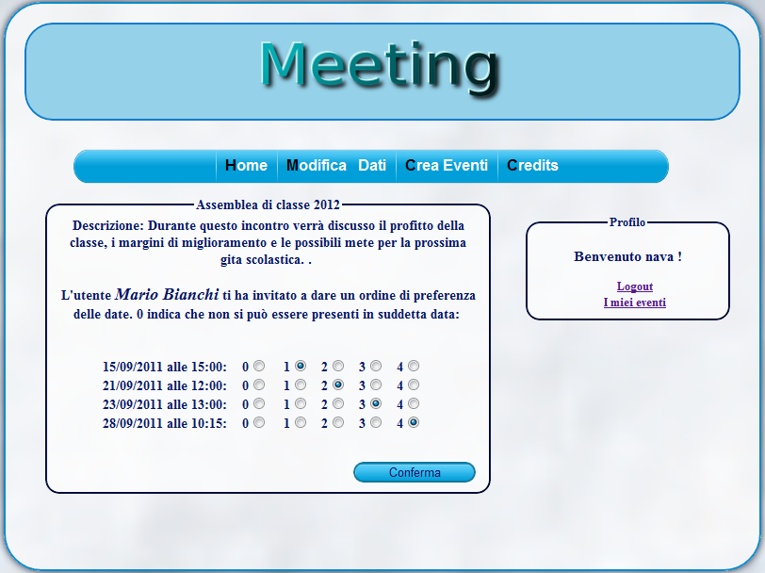

Slide 99
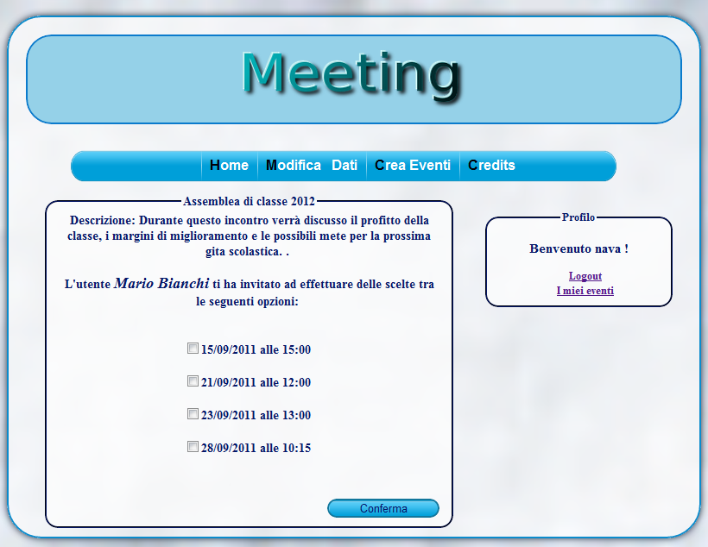

Slide 100
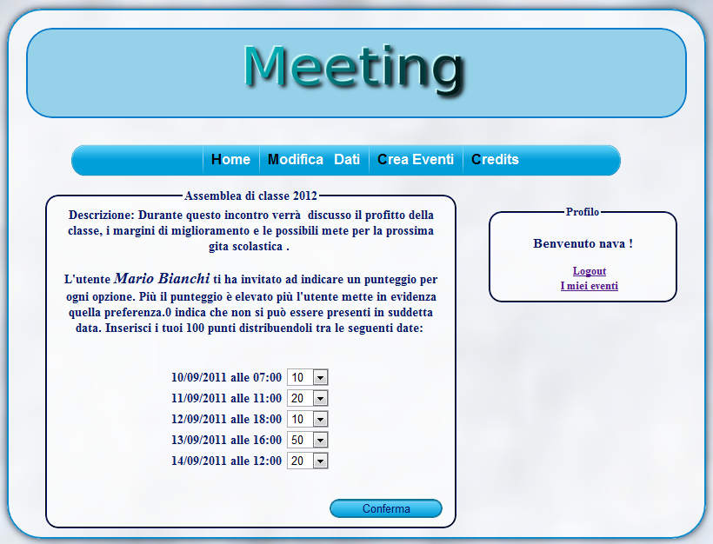

Slide 101

…it’s probably time for TIMEs’ coffee time

