Slide 1
A Language-Independent Approach To Smart Contract Verification
Xiaohong Chen, Daejun Park, Grigore Rosu University of Illinois at Urbana-Champaign, USA
November 05, 2018, ISoLA, Cyprus

Slide 2
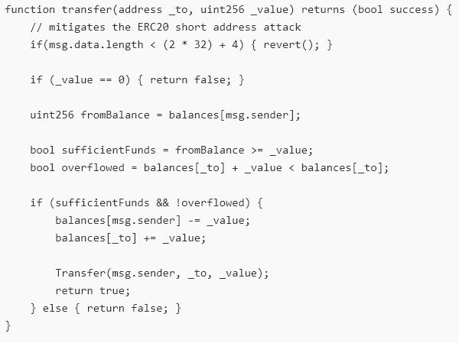
Smart Contract Snippet (ERC20) (one of the ~40,000 Ethereum ERC20s)
Written in Solidity:
…
ERC20 does not state that…
There should be no overflow when self-transfer…

Slide 3
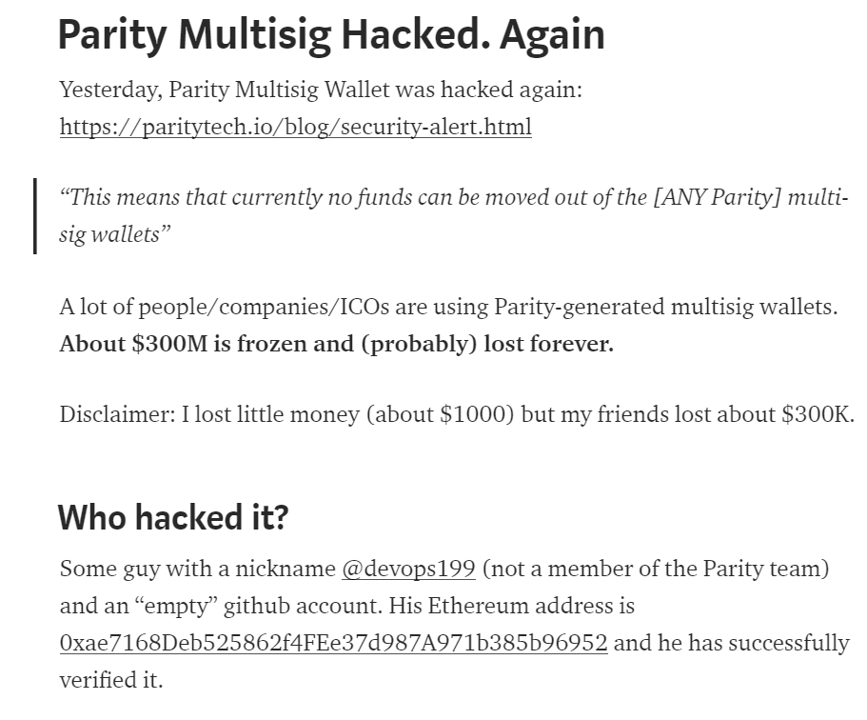
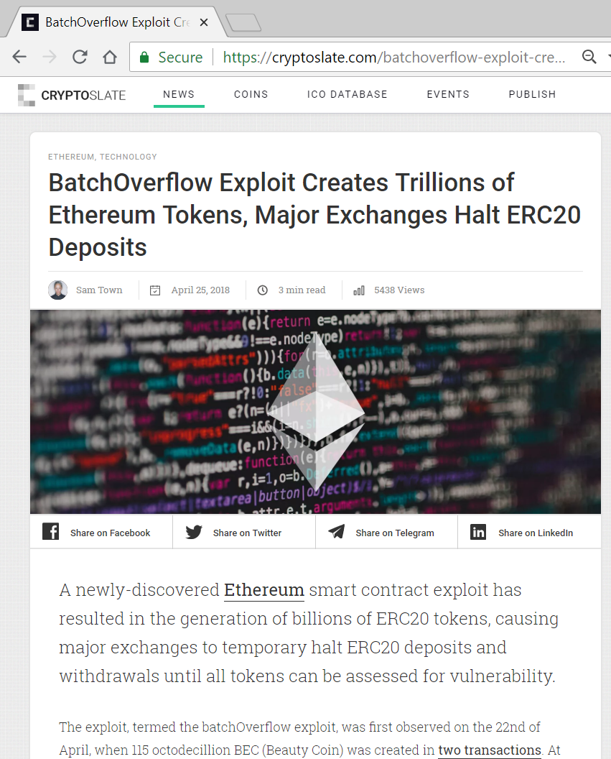
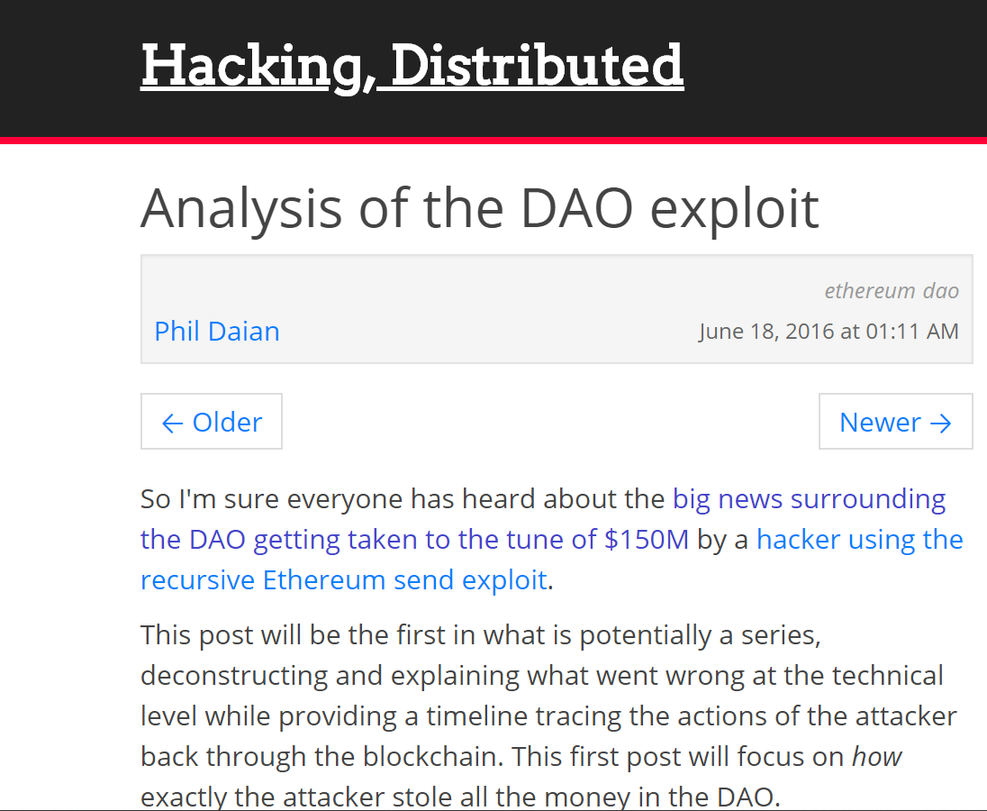
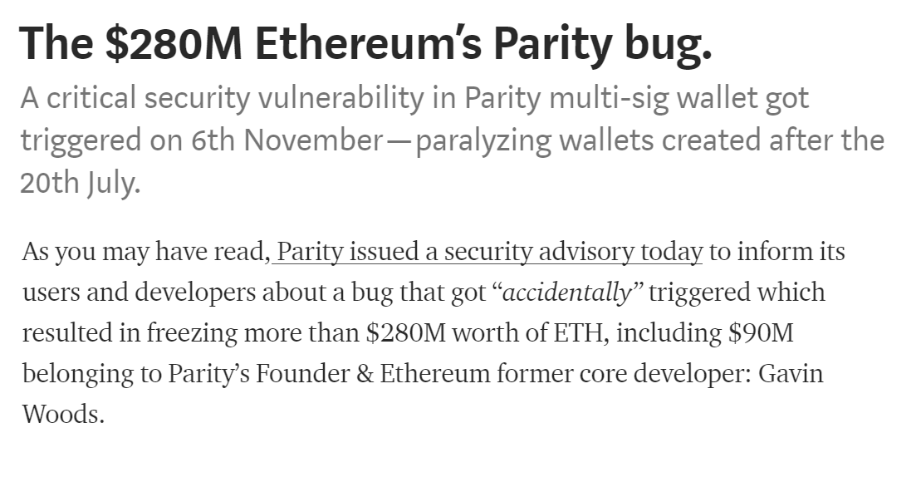
Attacks Happened. Many.
That’s larger than $10⁷⁰!

Slide 4
What Can We Do About It?
What can we do about execution environment to increase security?
Unacceptable to build this complex potentially disruptive technology on top of poorly designed VMs and PLs.
Ideal scenario feasible,
stop compromising!
Everything must be rigorously designed, using formal methods. Implementations provably correct!
Clients: provably correct VMs
Smart contracts: well-designed PLs, with provably correct compilers or interpreters
Verification: smart contracts provably correct wrt their specs.
Written in high-level languages (Solidity, Vyper, etc.)
Informal smart contract standards
Smart contracts running on VMs
Blockchain clients
Consensus algorithms and protocols

Slide 5
Ideal language framework vision
…
Deductive program verifier
Parser
Interpreter
Formal Language Definition
(Syntax and Semantics)
Model checker
Compiler
Symbolic execution
(semantic) Debugger
Notes:
K is a language design framework and suite of tools.
Its vision is to allow and encourage the language designers to formally define their languages once and for all, using an intuitive and attractive notation, and then obtain essentially for free implementations as well as analysis tools for the defined languages.
This is a long-standing dream of the programming language community.
Our objective in the K project is to develop the foundations, techniques, and tools to make this dream a reality.

Slide 6
Our Attempt: the K Framework http://kframework.org
We tried various semantic styles, for ~15y
Small-/big-step SOS; Evaluation contexts; Abstract machines (CC, CK, CEK, SECD, …); Chemical abstract machine; Axiomatic; Continuations; Denotational;…
But each of the above had limitations
Especially related to modularity, notation, verification
K framework initially engineered: keep advantages and avoid limitations of various semantic styles
Then theory came

Slide 7
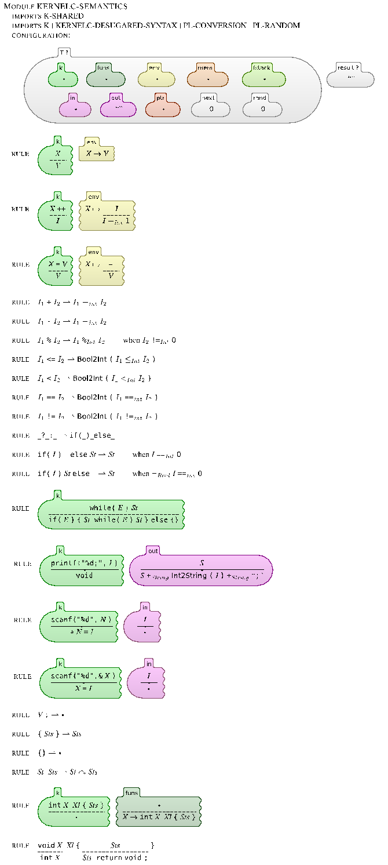
Complete K definition of KernelC
Notes:
Here is a complete definition of a fragment of C, called KernelC, as generated by the K tool.
The left column defines its formal syntax and the other two its formal semantics.
I will next zoom through this definition and highlight some of the K tool’s features.

Slide 8
Complete K definition of KernelC
Syntax declared using annotated BNF
…
Notes:
Syntax is declared using the conventional BNF notation, annotated with K attributes (in blue).
For example, assignment is an expression construct taking two expression arguments (the left one can be a variable x, a pointer *x, etc.; we only discuss the former case here).
The “strict(2)” annotation states that assignment is strict in the second argument, that is, that argument needs to be evaluated first.
The semantic rule of assignment, which we discuss shortly, then can assume that the second argument is already a value.

Slide 9
Complete K definition of KernelC
Configuration given as a nested cell structure.
Leaves can be sets, multisets, lists, maps, or syntax
Notes:
K makes heavy use of configurations, which in the tool can be defined and initialized in a user friendly and colorful way.
A configuration can be regarded as a snapshot of the program execution: it includes the remaining program, together with all the necessary semantic information to execute it.
K configurations are organized as nested cell structures, whose leaves hold basic data organized in lists, maps, sets, etc.
Cells can be referred to by their name; their order is irrelevant.
In KernelC, the k cell holds the remaining code, funs the set of functions, env the current environment, mem the current heap, fstack the current function stack, in and out the current input/output buffers, ptr the current malloc/free pointer map, and so on.

Slide 10
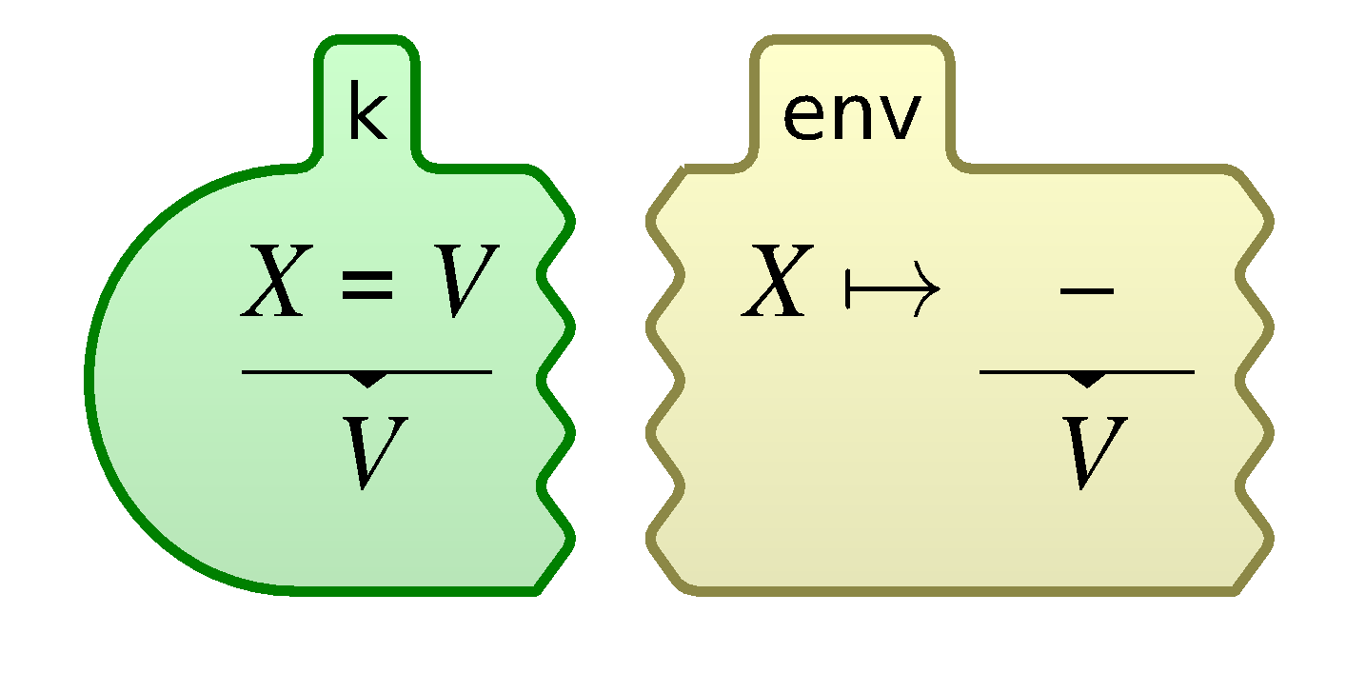
Complete K definition of KernelC
Semantic rules given contextually
rule
<k> X = V => V …</k>
<env>… X |-> (_ => V) …</env>
Notes:
Once the syntax and configuration are defined, we can start adding semantic rules.
K rules are contextual: they mention a configuration context in which they apply, together with local changes they make to that context.
To enhance the modularity of your language definition, you typically aim at only mentioning the absolutely necessary context in your rules; the remaining details are filled in automatically by the tool.
For example, here is the K rule for assignment, both in graphical and in ASCII formats; we only discuss the graphical notation here.
Recall that assignment was strict(2), so we can assume that its second argument is a value, say V.
The context of this rule involves two cells, the k cell which holds the current code and the env cell which holds the current environment.
Moreover, from each cell, we only need certain pieces of information: from the k cell we only need the first task, which is the assignment X=V, and from the env cell we only need the binding X |-> _. The underscore stands for an anonymous variable, the intuition here being that that value is discarded anyway, so there is no need to bother naming it.
The unnecessary parts of the cells, which we call frames, are metaphorically “torn away” and ignored, as suggested by the tears.
Then, once the local context is established, we identify the parts of the context which need to change, underlying them, and then provide the changes under the lines.
In our case, we rewrite both the assignment expression and the value of X in the environment to the assigned value V.
Everything else stays unchanged.
The concurrent semantics of K regards each rule as a transaction: all changes in a rule happen concurrently; moreover, rules themselves apply concurrently, provided their changes do not overlap.

Slide 11
K scales
Several large languages were recently defined in K:
Java 1.4: by Bogdanas etal [POPL’15]
800+ program test suite that covers the semantics
JavaScript ES5: by Park etal [PLDI’15]
Passes existing conformance test suite (2872 programs)
Found (confirmed) bugs in Chrome, IE, Firefox, Safari
C11: Ellison etal [POPL’12, PLDI’15]
192 different types of undefined behavior
10,000+ program tests (gcc torture tests, obfuscated C, …)
Commercialized by startup (Runtime Verification, Inc.)
… + EVM, IELE, Plutus, Solidity, Vyper
Notes:
K scales!
Besides a series of smaller and paradigmatic languages that are used for teaching purposes, there are several large and real languages that have been given semantics in K, such as:
Java has been defined by Bogdanas;
Javascript by Park and Stefanescu;
C by Ellison etal;
just to mention a few.
Many other large K semantics are under development.

Slide 12
Ideal Language Framework Vision [K]
…
Deductive program verifier
Parser
Interpreter
Formal Language Definition
(Syntax and Semantics)
Model checker
Compiler
Symbolic execution
(semantic) Debugger

Slide 13
State-of-the-Art
Redefine the language using a different semantic approach (Hoare/separation/dynamic logic)
Language specific, non-executable, error-prone

Slide 14
What We Want
Deductive program verifier
Formal Language Definition
(Syntax and Semantics)
Use directly the trusted
executable semantics!
Language-independent proof system
Takes operational semantics as axioms
Derives reachability properties
Sound and relatively complete for all languages!
Symbolic execution

Slide 15
Matching Logic
[…, LICS’13, RTA’15, OOPSLA’16, FSCD’16, LMCS’17, …]
Patterns
(of each sort s)
Structure
Constraints
Binders

Slide 16
Matching Logic Models
Patterns interpreted as sets (all elements that match them)
¬ as complement, ∧ as intersection, ∃ as union over all x

Slide 17
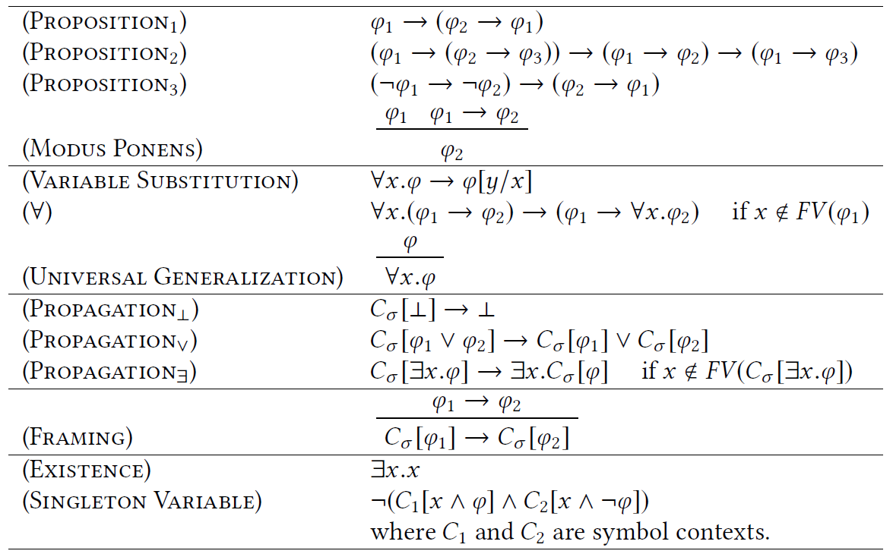
Matching Logic Proof System
First-Order Logic
13 Proof rules. Sound and complete
C_{σ} ≡ σ(ψ₁,…, ψ_{i-1},□, ψ_{i+1},…, ψ_{n})
Technical (completeness)
Local reasoning

Slide 18
Expressiveness
Important logics for program reasoning can be framed as matching logic theories / notations
First-order logic
Equality, membership, definedness, partial functions
Lambda / mu calculi (least/largest fixed points)
Modal logics
Hoare logics
Dynamic logics
LTL, CTL, CTL*
Separation logic
Reachability logic
…
λx.e ≡ ∃x.λ⁰(x,e)
(λx.e)e’ = e[e’/x]
μx.e ≡ ∃x. μ⁰(x,e)
μx.e = e[μx.e/x]
[e[ψ/x] → ψ] → [μx.e → ψ]
Knaster-Tarski

Slide 19
Reachability Logic (Semantics of K) [LICS’13, RTA’14, RTA’15,OOPLSA’16]
“Rewrite” rules over matching logic patterns:
Patterns generalize terms, so reachability rules capture rewriting, that is, operational semantics
Reachability rules capture Hoare triples
Sound & relative complete proof system
Now proved as matching logic theorems
Can be expressed in matching logic:
ϕ → ◊(ϕ’) ◊ is “weak eventually”
[FM’12]
≡

Slide 20
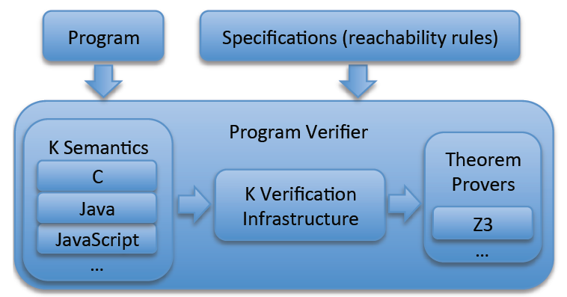
K = (Best Effort) Implementation of RL
Reachability logic implemented in K, generically
Evaluated it with the existing semantics of C, Java, and JavaScript, and several tricky programs
Morale:
Performance is not an issue!
EVM
IELE
Plutus
Solidity
…

Slide 21
K framework vision
…
Deductive program verifier
Parser
Interpreter
Blockchain Language Definition
Formal Language Definition
(Syntax and Semantics)
Model checker
Compiler
Symbolic execution
(semantic) Debugger

Slide 22
KEVM: formal executable semantics of the Ethereum VM
[CSL’18]
In Collaboration with IOHK
Defined complete semantics of EVM in K
https://github.com/kframework/evm-semantics
Passes all 40,683 tests of C++ reference impl.
Only one order of magnitude slower than the official C++ implementation

Slide 23
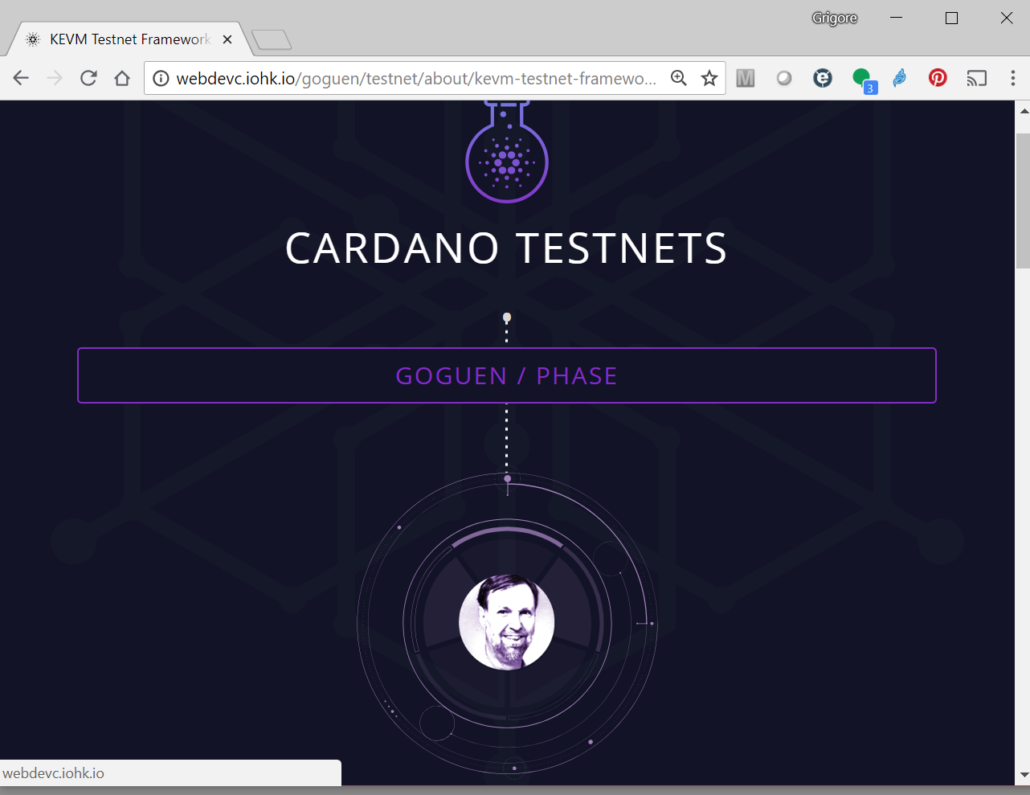
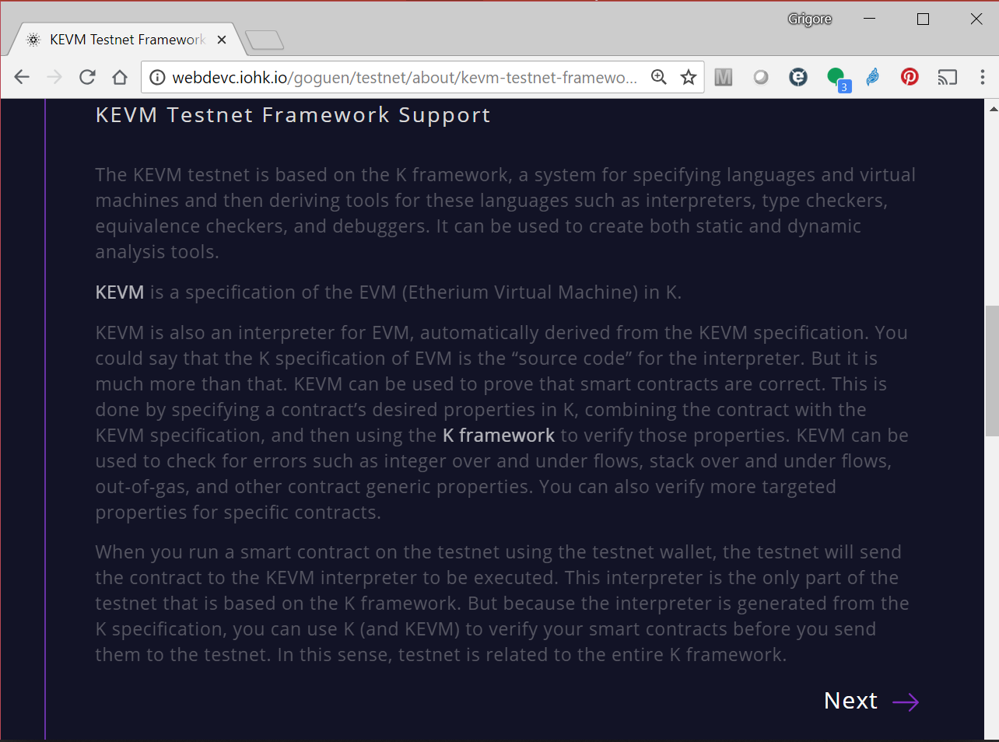
What Can We Do with KEVM?
1) Generate and deploy correct-by-construction EVM client! IOHK has just done that, in collaboration with RV, as a Cardano testnet:

Slide 24
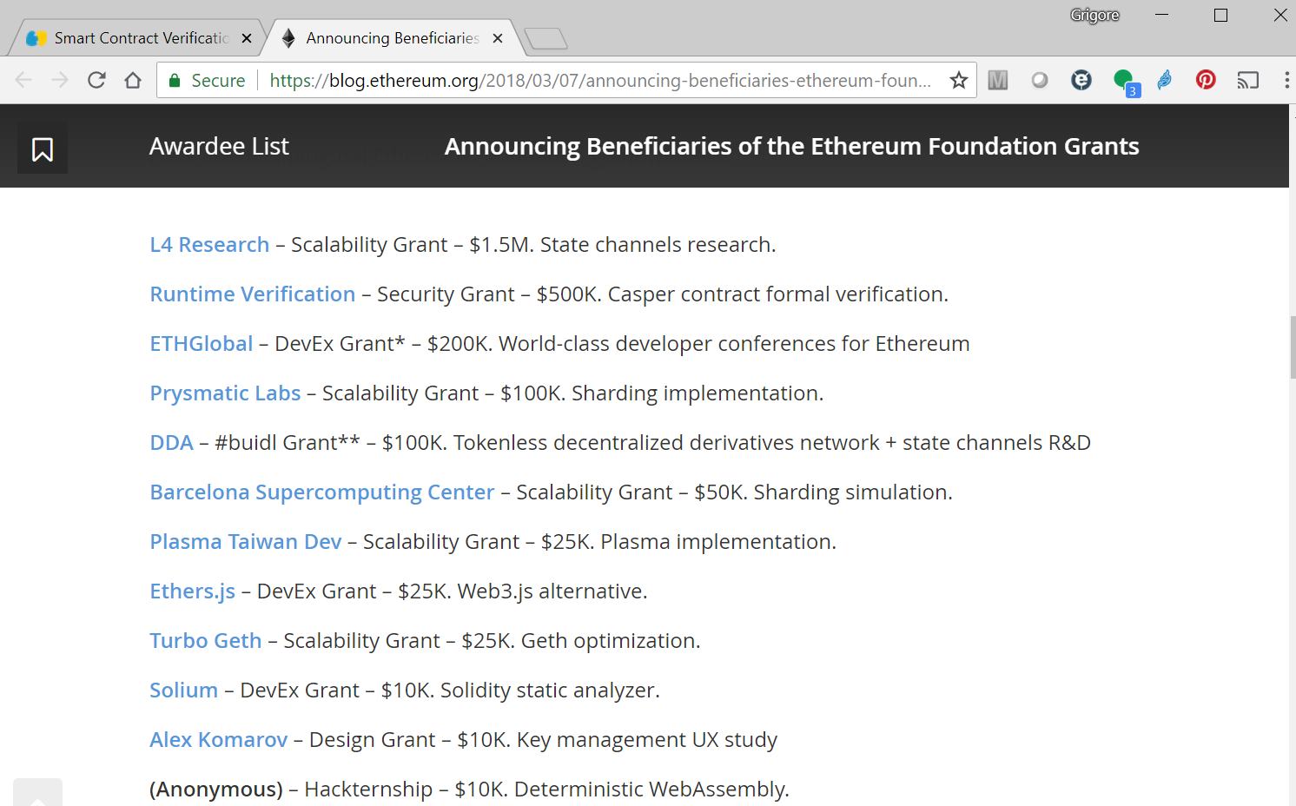
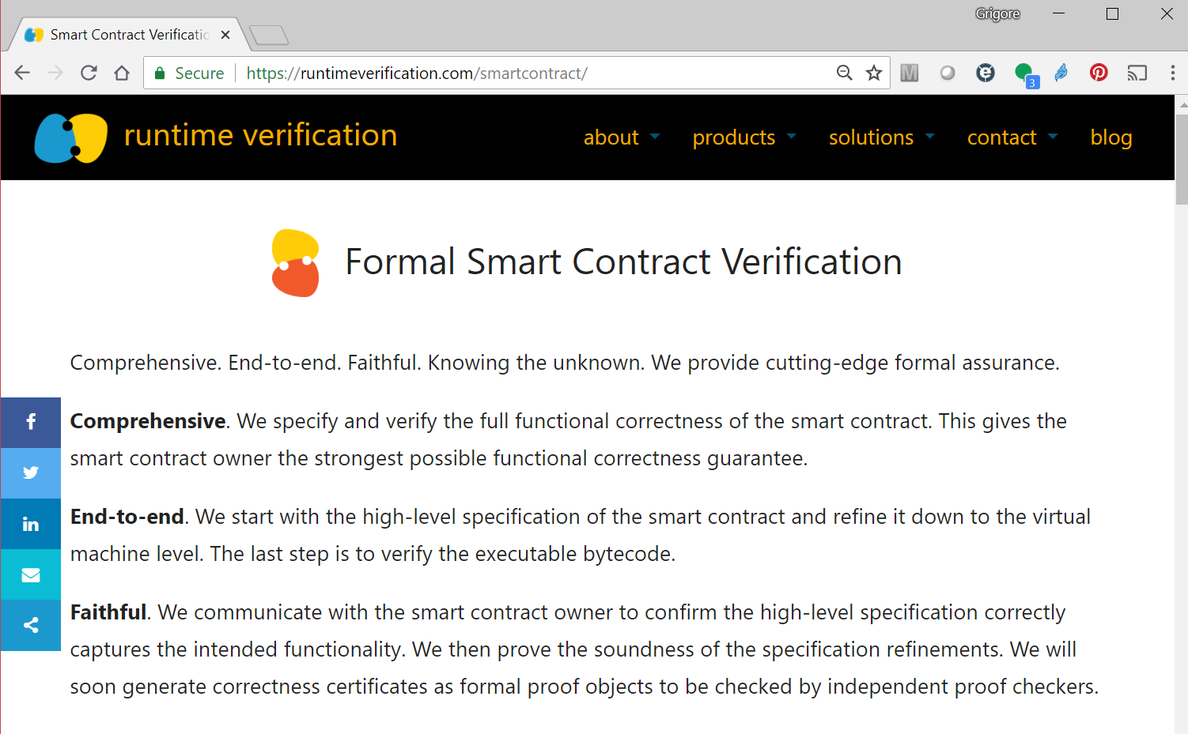
What Can We Do with KEVM?
2) Formally verify Ethereum smart contracts! RV is doing that, commercially. RV also won Ethereum Security grant to verify Casper.

Slide 25
Smart contract verification workflow
ERC20 Informal Business Logic
rule <k> transfer(To, Value) => true ...</k>
<caller> From </caller>
<account>
<id> From </id>
<balance> BalanceFrom => BalanceFrom -Int Value </balance>
</account>
<account>
<id> To </id>
<balance> BalanceTo => BalanceTo +Int Value </balance>
</account>
<log> Log => Log Transfer(From, To, Value) </log>
requires To =/=Int From // sanity check
andBool Value >=Int 0
andBool Value <=Int BalanceFrom
andBool BalanceTo +Int Value <=Int MAXVALUE
[transfer]
callData: #abiCallData("transfer", #address(TO_ID), #uint256(VALUE))
gas: {GASCAP} => _
refund: _ => _
requires:
andBool 0 <=Int TO_ID andBool TO_ID <Int (2 ^Int 160)
andBool 0 <=Int VALUE andBool VALUE <Int (2 ^Int 256)
andBool 0 <=Int BAL_FROM andBool BAL_FROM <Int (2 ^Int 256)
andBool 0 <=Int BAL_TO andBool BAL_TO <Int (2 ^Int 256)
[transfer-success]
k: #execute => (RETURN RET_ADDR:Int 32 ~> _)
localMem: .Map => ( .Map[ RET_ADDR := #asByteStackInWidth(1, 32) ] _:Map )
log: _:List ( .List => ListItem(#abiEventLog(ACCT_ID, "Transfer", #indexed(#address(CALLER_ID
……….
………
…….
Refinement
ERC20-K formal executable high-level spec
Refinement
ERC20-EVM formal executable low-level spec that contains all EVM details

Slide 26
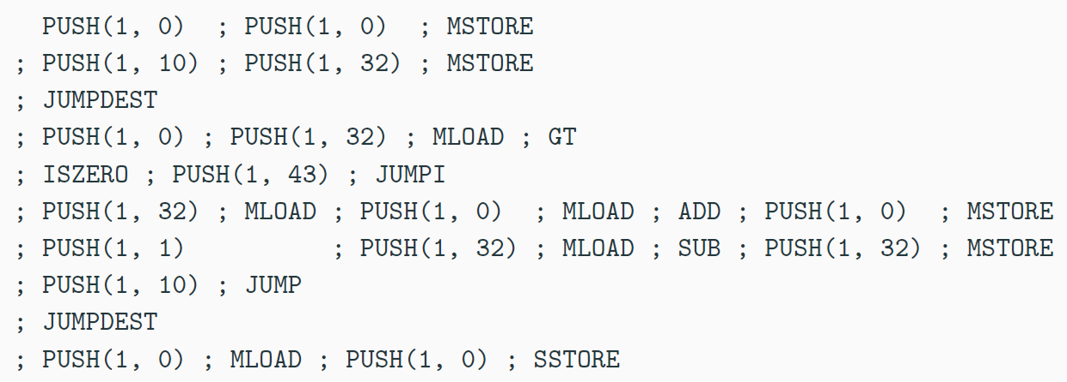
EVM Not Human Readable (among other nuisences)
If it must be low-level, then I prefer this:
define public @sum(%n) {
%result = 0
condition:
%cond = cmp le %n, 0
br %cond, after_loop
%result = add %result, %n
%n = sub %n, 1
br condition
after_loop:
ret %result
}

Slide 27
A New Virtual Machine (and Language) for the Blockchain
IELE testnet (with IOHK):
End of July’18
With tool ecosystem
Incorporates learnings from defining KEVM and from using it to verify smart contracts
Register-based machine, like LLVM; unbounded*
IELE was designed and implemented using formal methods and semantics from scratch!
Until IELE, only existing or toy languages have been given formal semantics in K
Not as exciting as designing new languages
We should use semantics as an intrinsic, active language design principle, not post-mortem

Slide 28
K Semantics of Other Blockchain Languages
WASM (web assembly) – in progress, by the Ethereum Foundation
Solidity – in progress, collaboration between RV and Sun Jun’s group in Singapore
Plutus (functional) – in progress, by RV following Phil Wadler’s (@IOHK) design of the language
Vyper – in progress, by RV in collaboration with the Ethereum Foundation
…

Slide 29
Conclusion: This Can Be Done.
…
Deductive program verifier
Parser
Interpreter
Blockchain Languages Definition
Formal Language Definition
(Syntax and Semantics)
Model checker
Compiler
Symbolic execution
(semantic) Debugger
Notes:
simple, small, easier
incentive

